Slide 2
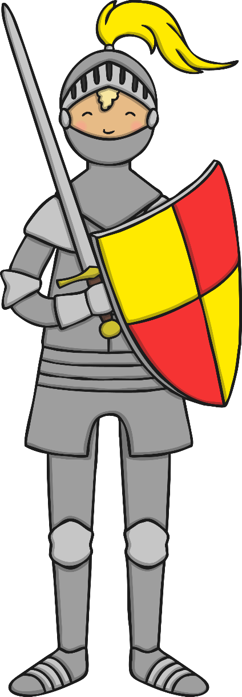
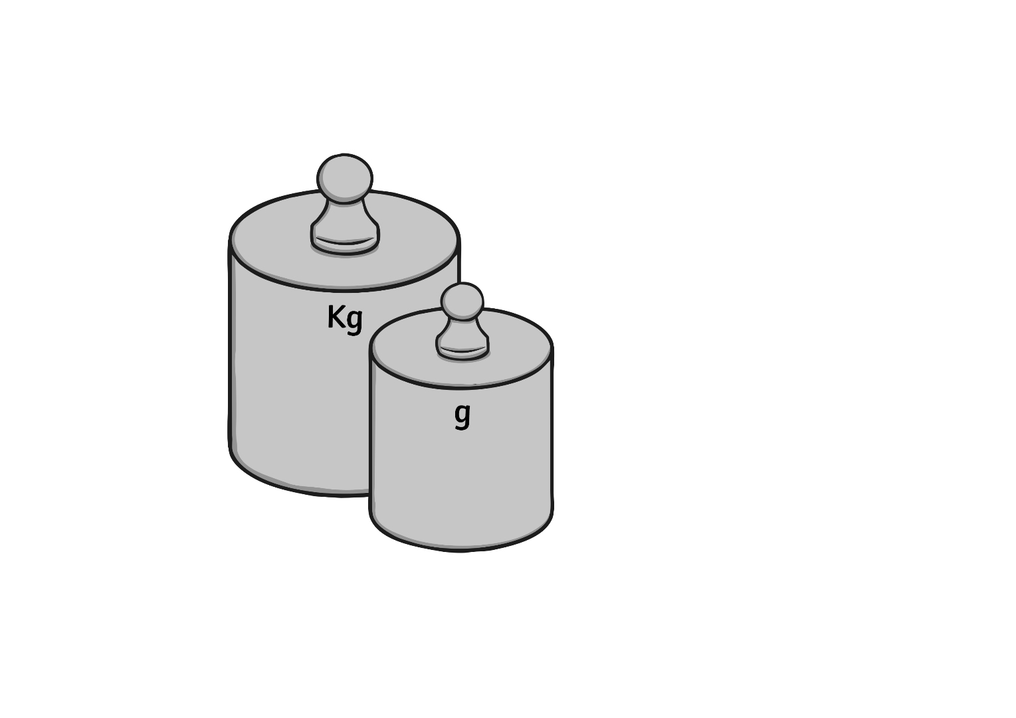
What Is Armour?
Armour is a special suit made from metal. Knights would wear armour to protect themselves in battle and in tournaments.
Armour is usually made of metal. This means that it is very heavy and difficult to move around in.

Slide 3
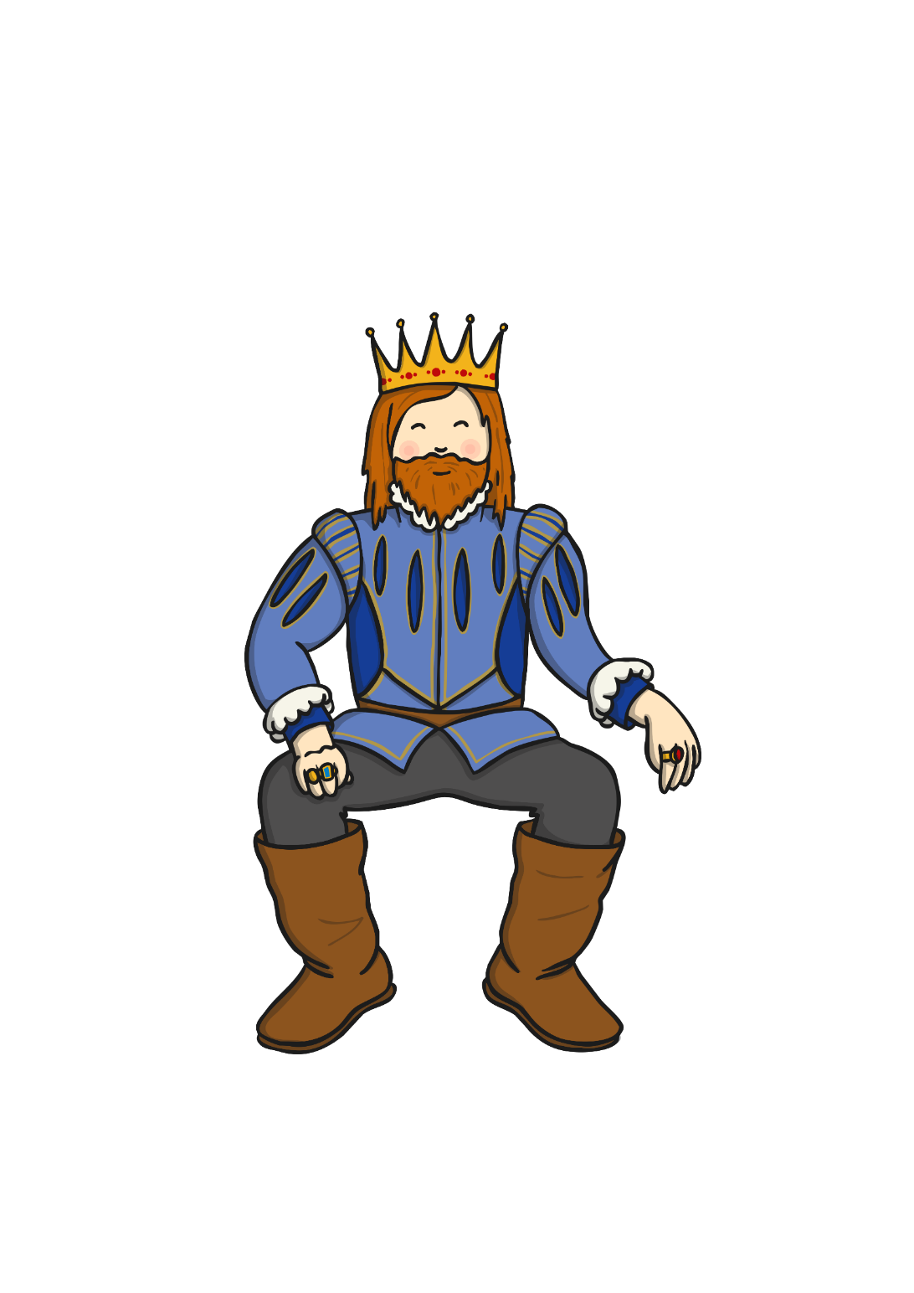
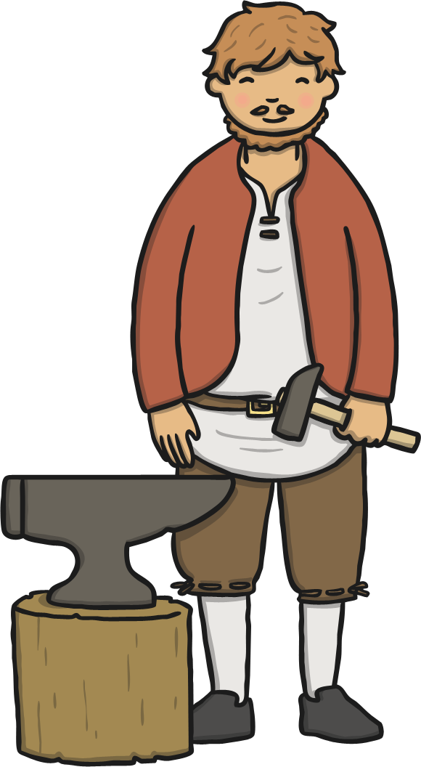
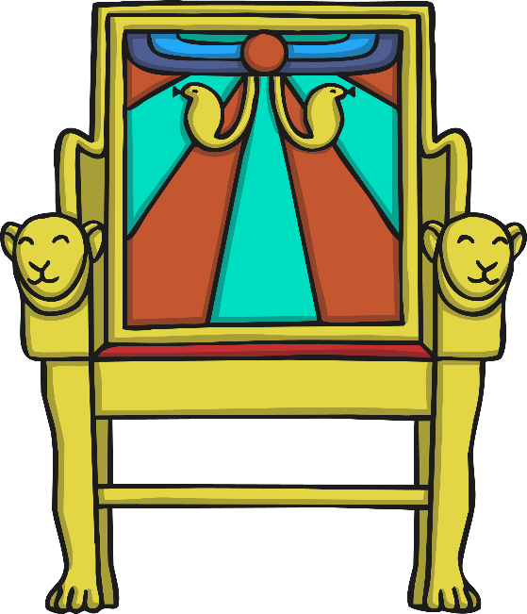
What Is Armour?
Kings and other noblemen often had fancy armour made for them. This armour would often have elaborate, gold patterns and sometimes had fearsome creatures, such as lions, on it.

Slide 4

Helmet
The helmet is an important part of a knight’s armour. It covers all of the head, including the back of the head and the neck, protecting it from attacks.
The visor is a special eye shield which can be pulled down to protect the eyes. It has small holes in it so knights can still see.
visor

Slide 5
Throat Guard
The throat guard, or gorget, protects the front and the back of the neck from weapons.
Throat guards also reach across towards the shoulders, covering the top part of the chest and back.
throat guard

Slide 6
Shoulder Guard
The shoulder guard, or pauldron, protects shoulders from weapons.
Shoulder guards are domes of metal, which sit on top of the shoulders and the top of the arm.
shoulder guard

Slide 7
Breast Plate
The breast plate, or cuirass, protects the chest from weapons.
The breast plate is made of two pieces, one for the front and one for the back. They are held together with leather straps and buckles.
breast plate

Slide 8
Chainmail
Chainmail is worn underneath a suit of armour as an extra layer of protection.
Chainmail is made of thousands of tiny metal rings, all looped together. It is very strong but extremely heavy.
chainmail

Slide 9
Gauntlets
Gauntlets are metal gloves, which knights would wear to protect their hands.
It is very hard to use weapons while wearing gauntlets.
gauntlets

Slide 10
Cuisses
Cuisses are plates of metal which cover the thighs.
Some cuisses only protect the front of the thigh, but most have a plate covering the front and another covering the back.
cuisses

Slide 11
Leg Plates
Leg plates, or greaves, are plates of metal which cover the lower legs.
Leg plates start from the knees and finish at the ankles. They open and close using hinges and are fastened with straps and buckles.
leg plates

Slide 12
Sword
Many knights used a sword as their weapon of choice.
Swords come in all different shapes and sizes. Some swords are one-handed so that they can be used with a shield. Other swords are much bigger and need to be used with two hands.
sword

